Slide 1
Ontologies for Representing Neoplasms
William Duncan
Alexander Diehl

Slide 2
What is a Neoplasm?
Per Wikipedia: A Neoplasm is a type of abnormal and excessive growth of tissue. When it forms a mass, it may be called a tumor.

Slide 3
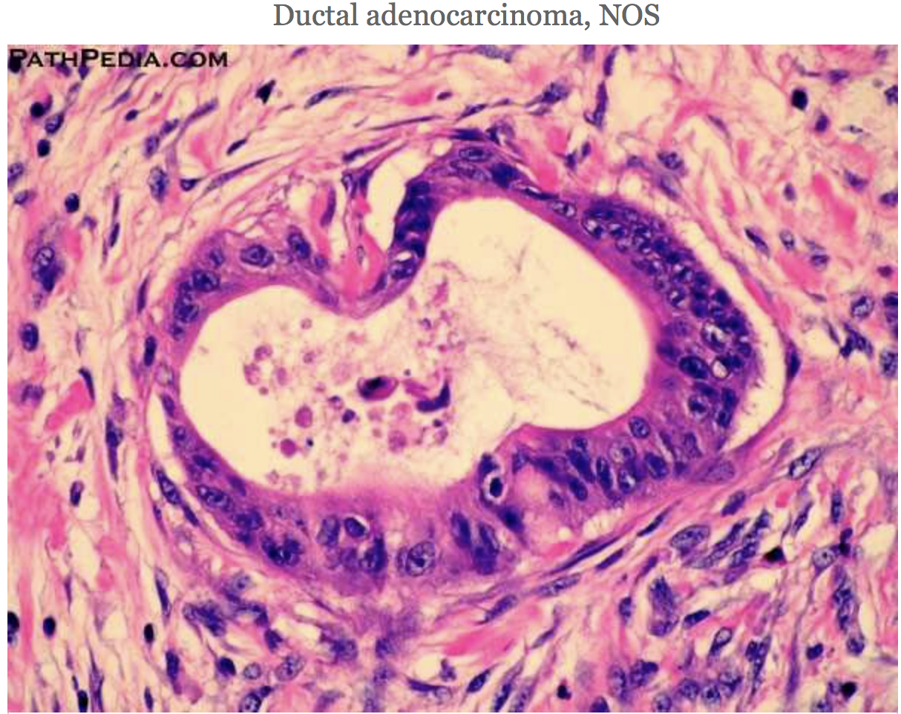
Examples
Cheek cell neoplasm
Intraductal papillary mucinous neoplasm
[Wikipedia and Pathopedia]

Slide 4
OBO Foundry Representation of Neoplasm
Disease Ontology (DO)
Experimental Factor Ontology (EFO)
Mouse Pathology Ontology (MPATH)
Human Phenotype Ontology (HPO)
NCI Thesaurus (NCIT)
Monarch Disease Ontology (MONDO)
Ovarian Cancer Ontology (OVO)

Slide 5
Disease Ontology (DO)
A disease is a disposition (per OGMS)
Disease of cellular proliferation has exact synonym neoplasm
Def: A disease that is characterized by abnormally rapid cell division
Neoplasms are material entities DO has neoplasms under disease
Benign neoplasm, malignant ovarian cyst, and many more ...

Slide 6
Experimental Factor Ontology (EFO)
Same structure as Disease Ontology.

Slide 7
Mouse Pathology Ontology (MPATH)
Pathological entity
Pathological anatomical entity
Neoplasm
Pathological entity: Pathological structure or process
Pathological anatomical entity: Anatomically located instance of pathological response or entity.
Neoplasm: A tumor resulting from abnormal and uncontrolled autonomous new cell growth (proliferation)that may be benign or malignant.

Slide 8
Human Phenotype Ontology (HP)
Phenotype (undefined)
Abnormal phenotype (undefined)
Phenotypic abnormality (A phenotypic abnormality)
Neoplasm
Neoplasm: An organ or organ-system abnormality that consists of uncontrolled autonomous cell-proliferation which can occur in any part of the body as a benign or malignant neoplasm (tumor).
What is phenotype, abnormal phenotype?
What does it mean for a neoplasm to be a phenotype?

Slide 9
NCI Thesaurus (NCIT)
Disease, Disorder, or Finding
Disease or Disorder
Neoplasm
Disease or Disorder: Any abnormal condition of the body or mind that causes discomfort, dysfunction, or distress to the person affected or those in contact with the person.
Neoplasm: A benign or malignant tissue growth resulting from uncontrolled cell proliferation.

Slide 10
NCIT
What is a disease? Disorder?
Is okay to leave these primitives?
Metastasis is defined as a process, but why not a disease or disorder?
Metastasis has material entities as subtypes.

Slide 11
Monarch Disease Ontology (MONDO)
Includes multiple definitions of neoplasm:
MPATH
HP
NCIT
But are these compatible?

Slide 12
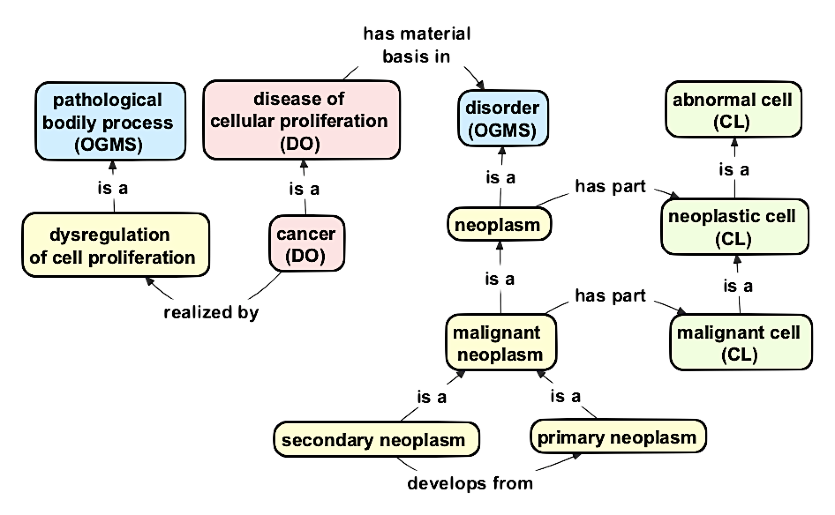
Duncan, Gaudioso, Diehl

Slide 13
Duncan, Gaudioso, Diehl
material anatomical entity: An anatomical entity that has mass
anatomical structure: A material anatomical entity that is a single connected structure with inherent 3D shape generated by coordinated expression of the organism's own genome
pathological anatomical structure: A material entity that comes into being as a result of changes in some pre-existing anatomical structure through processes other than the expression of the normal complement of genes of an organism of the given type, and is predisposed to have health-related consequences for the organism in question

Slide 14
Duncan, Gaudioso, Diehl
dysregulation of cell proliferation: A pathological bodily process that realizes uncontrolled cell proliferation
neoplasm: A disorder that results from uncontrolled cell proliferation

Slide 15
Conclusion
Definitions for neoplasm are very siloed.
How do we bring data about neoplasms together?
Is there a need for an OBO Foundry ontology of neoplasms?
What would be the benefits?
Who wants to be involved?
Future needs
Treatments for cancer
Molecular findings
Genomics

